Slide 1
Can you predict an NFL player’s success based off of their combine performance?
By: Sean O’Sullivan
4/17/20

Slide 2
Abstract
In This Experiment I wanted to find out if you could create an accurate classification tree to predict the success of an NFL player based solely off their NFL Combine statistics.
To do this I gathered the combine data for 949 players ranging from the years 2004-2014, as well as each players AV, a metric developed by Pro Football Reference that assigns a numerical value to each player depending on how valuable of a player they are. I used the rpart library of R to create a classification tree that predicted a players AV based off their combine performance, first with all players, then organized by position.
The classification tree was used on testing data which was combine data for players from 2000-2003. A player’s relative AV was calculated with a success rate of 40.7% when I organized the data by Linebackers. I had little success predicting how good an NFL player would be based off combine statistics for players at other positions.

Slide 3
The data
The NFL Combine is an event prior to the NFL Draft in which the prospects will participate in a variety of physical and mental tests.
For the purposes of my research the relevant tests were 40 Yard Dash, Vertical Jump, Bench Press Repetitions (225 lbs.), Broad Jump, Shuttle Run, and 3 Cone Drill.
Pro-Football Reference is a website that provides statistics for nearly all players past and present. In addition to having Combine results for most players, they assign most players an AV, a numerical value representing the value that that player brings to their team. The higher the AV, the more important the player is. AVs ranged from 0-142.
Since many players do not participate in all combine drills, I had to clean the data in order to narrow it down to players who had completed all 6 drills.
Player data from 2004-2014 was used for a sample size of 949 players

Slide 4
AV Grades
Rather than have numerical AV Values, AV Values were converted into a letter grade: A,B,C,D, or F.
I broke the AV Grades into deciles by running the code:
quantile(trainingAV, prob = seq(0, 1, length = 11), type = 5)
And Received the output:
0% 10% 20% 30% 40% 50% 60% 70% 80% 90% 100%
0 0 1 3 7 11 18 28 39 59 142
F corresponded to AV <=1
D corresponded to AV <=7
C corresponded to AV <=18
B corresponded to AV <=39
A corresponded to AV <=142

Slide 5
Methods - rpart
I used rpart to create a classification tree by running:
tree <- rpart(AVGrade ~ X40YD+Vertical+BenchReps+Broad.Jump+X3Cone+Shuttle,data=trainingData)
rpart.plot(tree)
The physical attributes required of NFL players vary greatly by position. While speed may be an extremely important factor for one position it may be nearly irrelevant for another position. Due to this the experiment was repeated on subsets of the data depending on the players position.

Slide 6
Methods – cross validation
To check the accuracy of the classification tree, the tree was used to predict the data on the training data set.:
predictedGrade<-predict(tree, newdata=trainingData, type="class”)
training_accuracy<-mean(predictedGrade==trainingData$AVGrade)
Then a cross validation was done to check for overfitting:
CrossValidation::cross_validate(trainingData, tree, 5, 0.7)

Slide 7
Results
Position | Training Accuracy
All Positions | 24.3%
Offensive Line | 53.2%
Defensive Backs | 48.7%
Running Backs | 47.6%
Safeties | 43.4%
Defensive Lineman | 50%
Linebackers | 55.6%

Slide 8
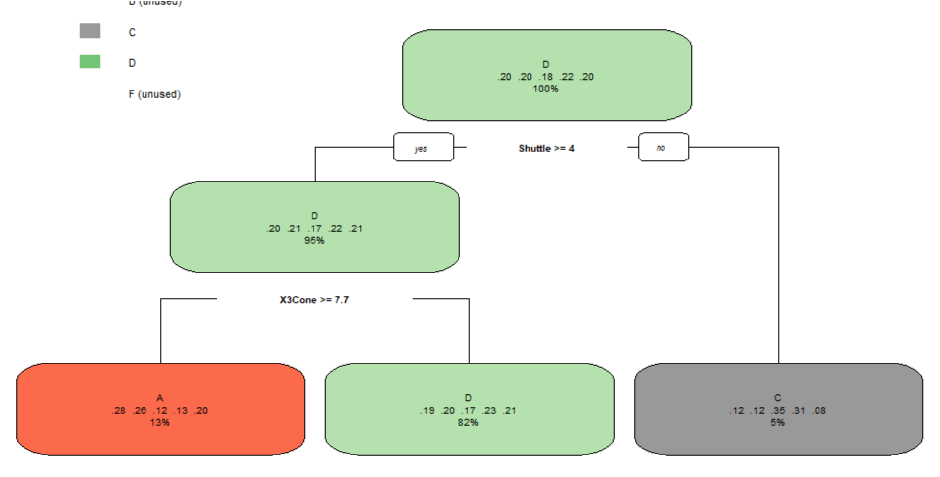
ALL Positions tree

Slide 9
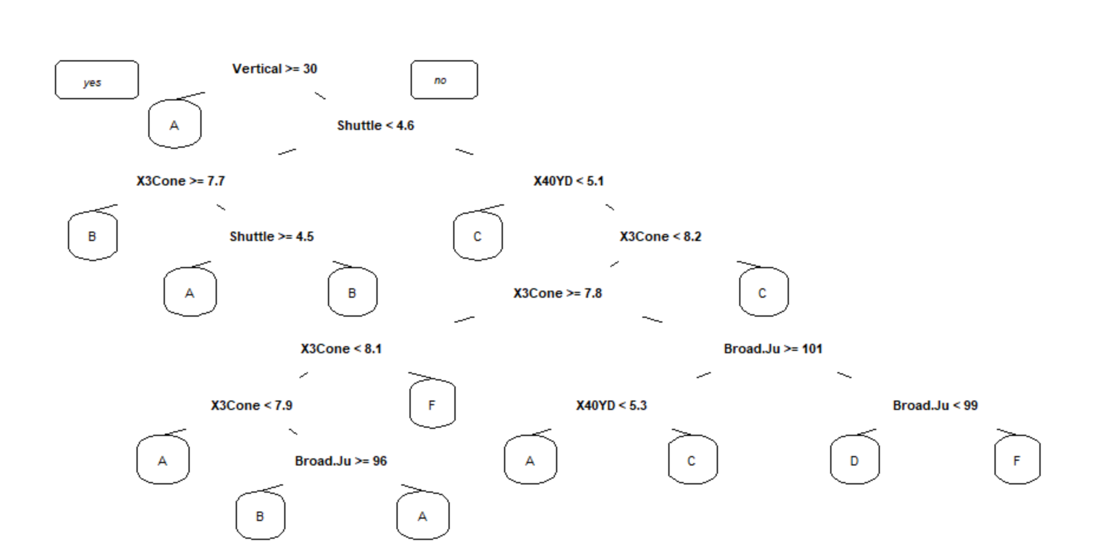
Offensive Line Tree

Slide 10
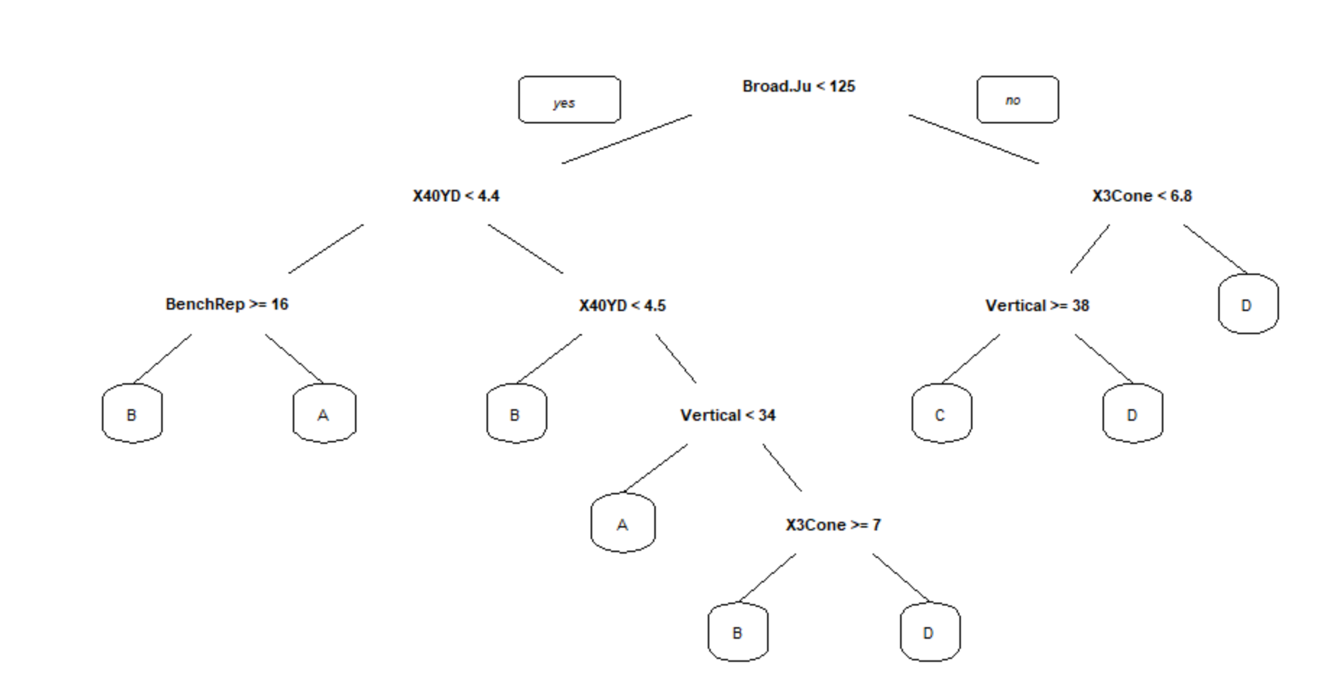
Defensive Backs Tree

Slide 11
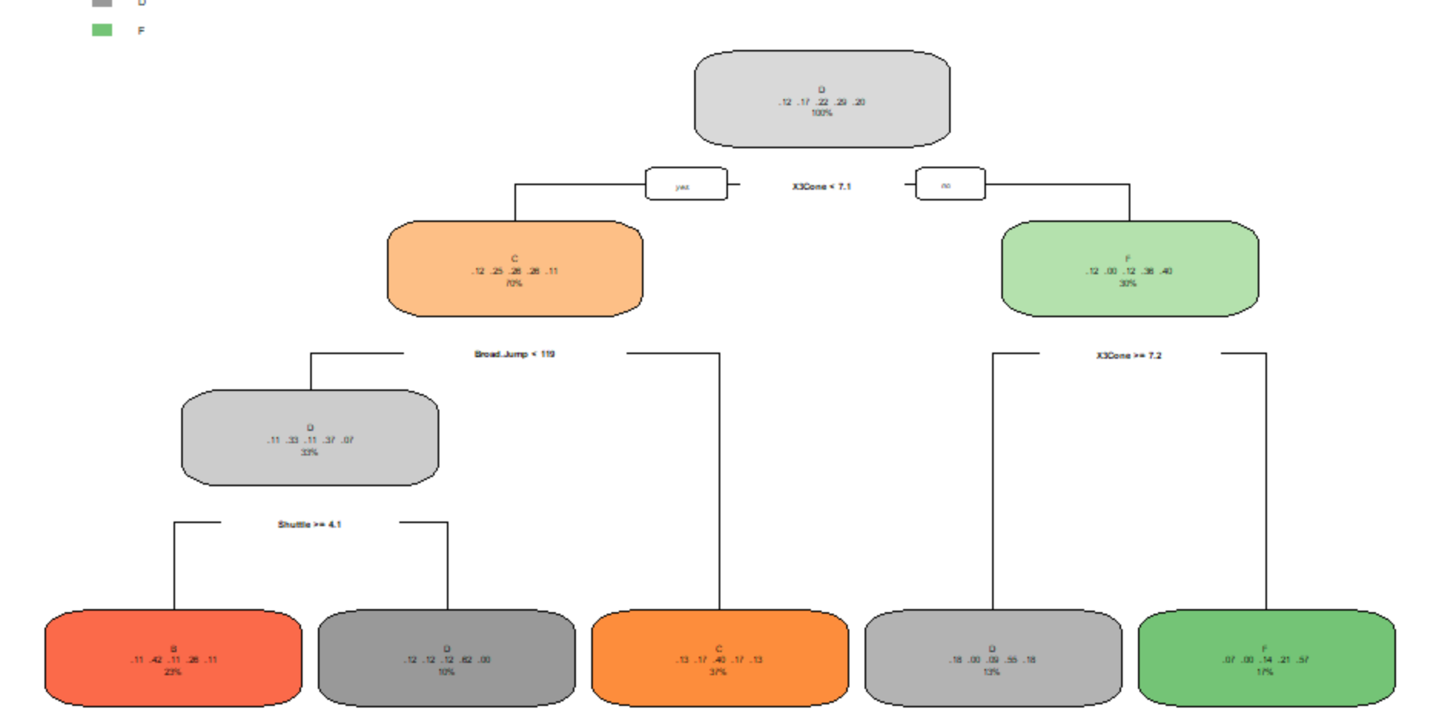
Running Backs Tree

Slide 12
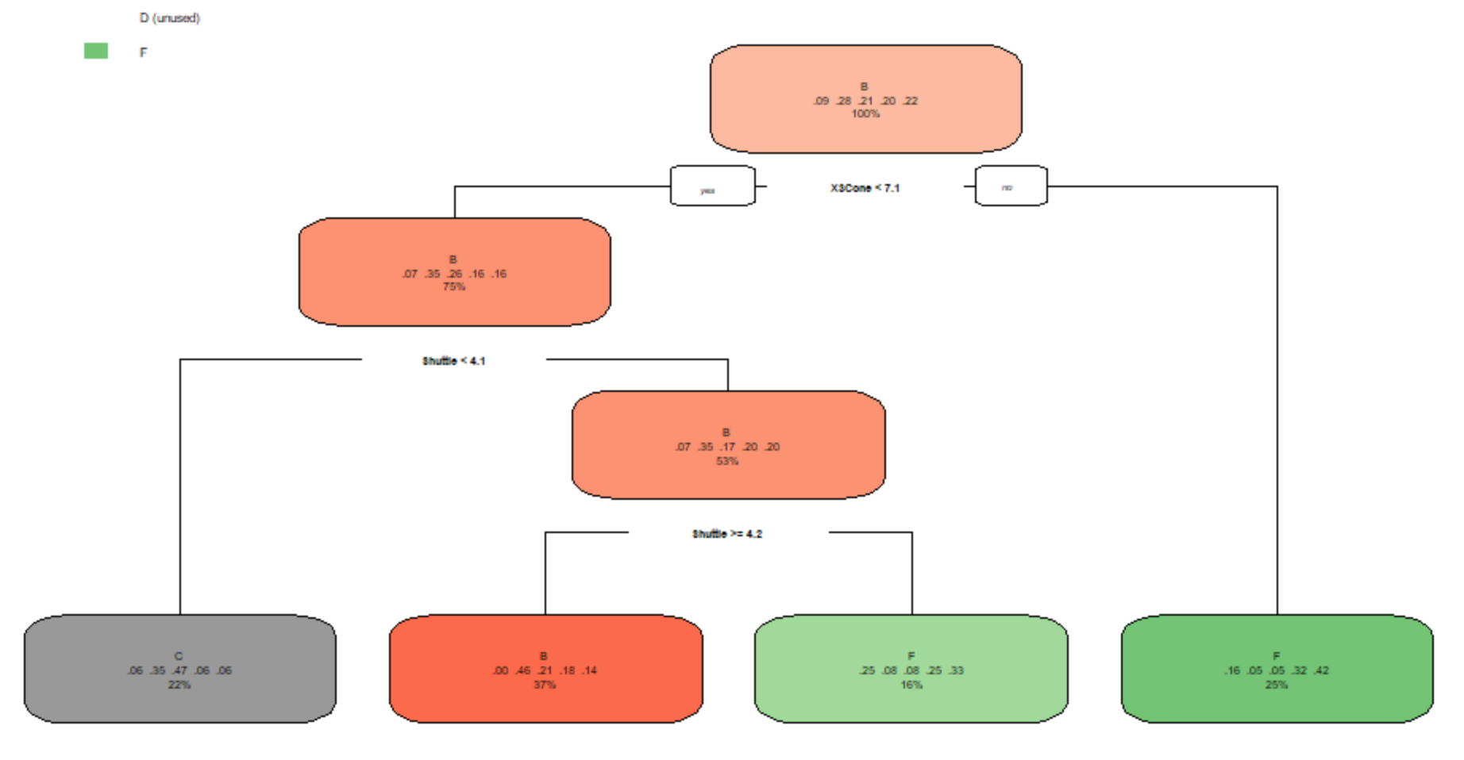
Safeties Tree

Slide 13
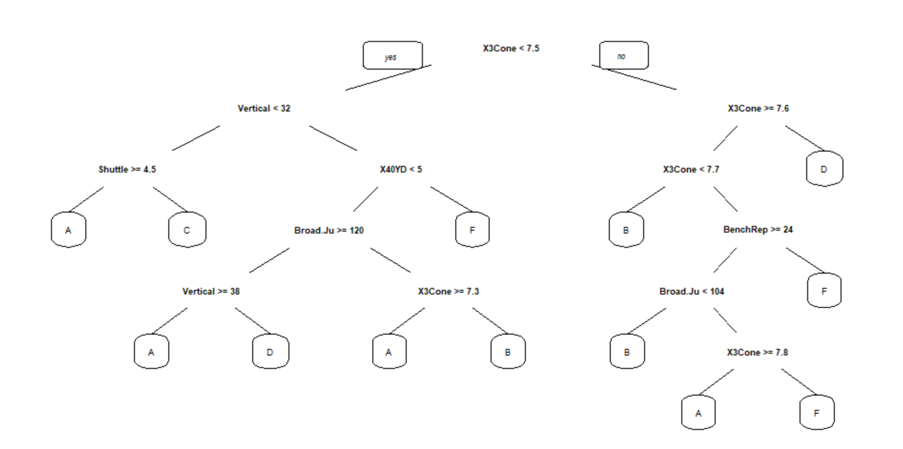
Defensive Lineman tree

Slide 14
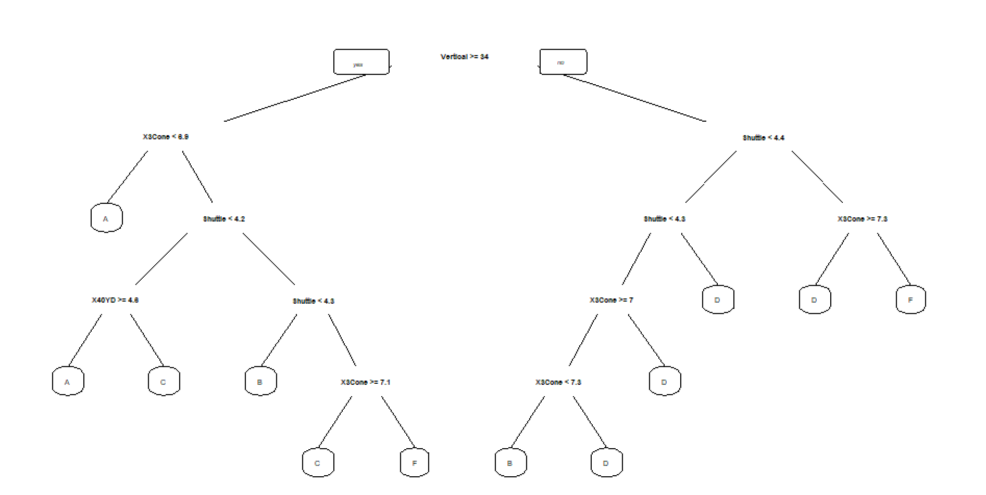
Linebackers tree

Slide 15
Result of cross validation with linebacker data and testing tree on linebacker data from 2000-2003
accuracy_Subset
50.3
46.7
49.8
48.6
52.9
Accuracy of testing on Linebacker combine data from 2000-2003= 40.7%

Slide 16
Discussion
Overall it is very difficult to predict how well a player will do based off their combine performance.
Evaluating an NFL prospect mainly happens by coaches and scouts watching hours and hours of actual game film. The Combine is a small snapshot of a player’s abilities.
Trying to create a classification tree with all positions grouped together does not work effectively
Only three positions were able to predict a grade on the training data set with a success rate of over 50%: Offensive Lineman, Defensive Lineman, and Linebackers.
Linebackers seemed to be the position group with the most potential to predict a player’s success based of their combine performance so that is the data subset I performed cross validation on and used to test on a different dataset (2000-2003 combine players).
Cross Validation accuracies were relatively close to training accuracies which meant that there was no overfitting.
My data suggests that certain position groups value certain events at the combine over others. For example, Safeties’ success seem to only rely on the Shuttle Run and the 3 Cone drill. Both events measure one’s agility.

Slide 17
Literature cited
http://data101.cs.rutgers.edu/laboratory/categories/prediction
https://cran.r-project.org/web/packages/rpart/rpart.pdf
https://www.pro-football-reference.com/

